Slide 1
Attention
Attention is all you need

Slide 2
What is happening..
Every single word in the input sequence is transformed into three different vectors : query, key, and value.
This allows the model to capture the relationship between each word and all other words in the sequence.
The Query vector represents the current word being processed and it is used to calculate the similarity between the current word and all other words in the sequence.
The Key vectors represent all words in the input sequence, and they are used to calculate the similarity between each word and all other words in the sequence.
The Value vector represent feature embeddings for each token ,it include context of each word.

Slide 3
Explaining with example
For example consider sentence with 5 input words
i,e “attention is all we need”
Walking through an example for the first word ‘attention’:
The keys are the input word vectors for all the other tokens, and for the query token too, i.e (semi-colon delimited in the list below): [ is ; all ; we ; need ] + [attention]
The word vector of the query is then Dot Product with the word vectors of each of the keys, to get 5 scalar numbers ,also known as “weights”.
This is to calculate the attention scores, this produces a set of similarity scores, which represent how similar each word is to the query word.
These weights are then scaled

Slide 4
Query and key

Slide 5
To calculate the attention weights we apply a softmax function to the normalized similarity scores to produce a set of attention weights. These weights represent the relative importance of each word in the sentence for the current query word.
Finally Calculate the weighted sum of the value vectors by Multiply each value vector with its corresponding attention weight. This produces a set of scaled value vectors, where each vector is weighted by its corresponding attention weight.
Sum the scaled value vectors. This produces a single vector that represents the weighted sum of the value vectors, and also represents the context of the query word
Now that we have the process for the word “I”, rinse and repeat to get word vectors for the remaining 4 tokens. We now have 5 output word vectors, each put through the Scaled Dot-Product attention mechanism.

Slide 6
For example, let's say we have a sentence with four words "I", "love", "natural", and "language". For each word, we have a query vector, a set of key vectors, and a set of value vectors. Let's assume that we have calculated the attention weights for the word "natural" using its query and key vectors, and we have the following attention weights:
[0.2, 0.3, 0.4, 0.1]
We can calculate the weighted sum of the value vectors as follows:
Multiply each value vector with its corresponding attention weight:
0.2 * value_vector_of_I + 0.3 * value_vector_of_love + 0.4 * value_vector_of_natural + 0.1 * value_vector_of_language
Sum the scaled value vectors:
weighted_sum_vector = 0.2 * value_vector_of_I + 0.3 * value_vector_of_love + 0.4 * value_vector_of_natural + 0.1 * value_vector_of_language
The resulted weighted sum vector represent context of the word “natural” weighted by its attention weights

Slide 7
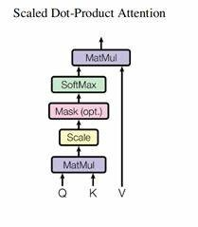

Slide 8

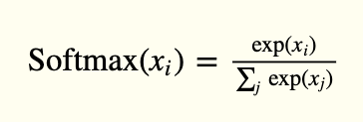
Maths

Slide 9
